Slide 1


ABAP on Hana s/4 Hana Training
Day 17
contact@anubhavtrainings.com

Slide 2

Agenda – Day 17
Create Fiori App with annotation File on Top of CDS
Describing SAP Analytics Cloud ( SAC )
Consume CDS in Analytics Cloud
Creating Dashboard’s on top of CDS in Analytics Cloud

Slide 3

End to End Flow of Creating Fiori App
Fiori App Development – Fiori Developer
After Creating CDS View we start SAP Business Application Studio
We Create a Fiori App, Choose Find Command → Fiori : Application Generator
Choose Free Style Fiori app, Enter the App name and the view name
Choose Radio Button Add Deployment Configuration to Yes
Go to view->Main.view.xml, Refer SAPUI5 sdk and create smart filter, smart table and a tree table control
Go to manifest.json and link a new annotation file
Create the annotation file with lineItem annotation to add columns to our table
Go to Run configuration and test the fiori app by connecting to the destination and UI5

Slide 4
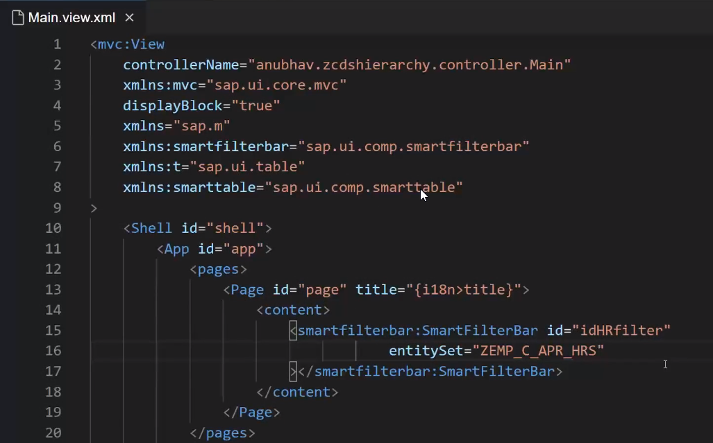
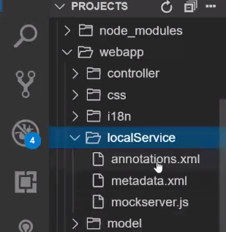
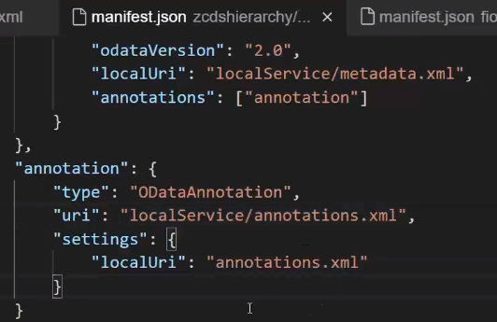
Creating Fiori app on top of CDS
2. Create and add Annotation file in our project.
1. To show All Data in Fiori App we Define or set the Entityset name in XML View.
3. Link annotation file use this code in Manifest.json.

Slide 5
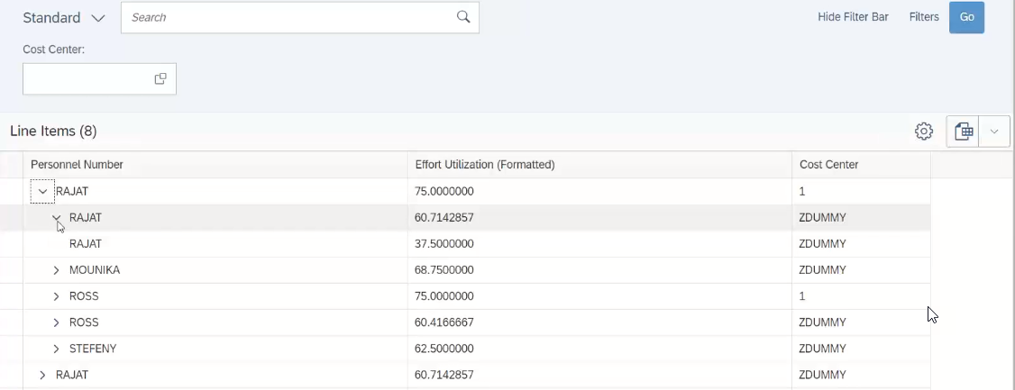
Result Employee Manager Hierarchy

Slide 6

When to go Free style v/s Fiori Element

Slide 7
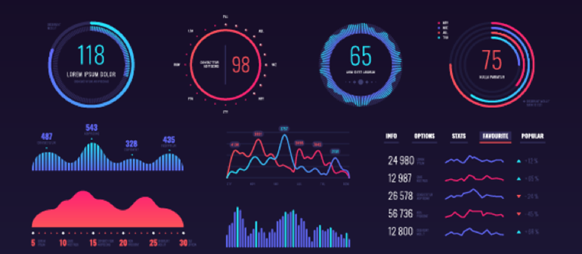
SAP Analytics Cloud ( SAC )
The SAP Analytics Cloud solution combines BI, augmented and predictive analytics, and planning capabilities into one cloud environment. As the analytics layer of SAP's Business Technology Platform, it supports advanced analytics enterprise-wide.
SAP Analytics cloud is a SaaS offering by SAP for complete BI, Planning, Predictive and designer capabilities.

Slide 8
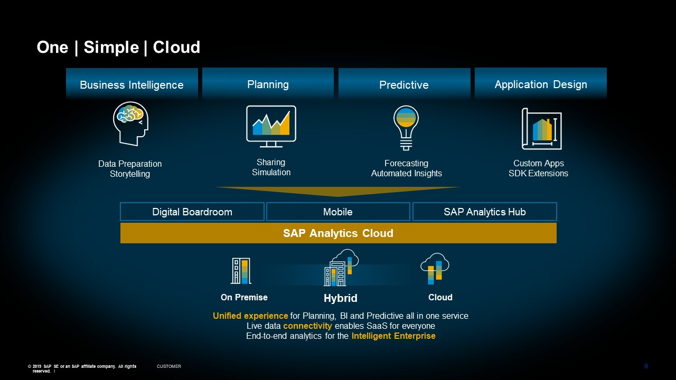
Phases of SAP Analytics Cloud ( SAC )

Slide 9
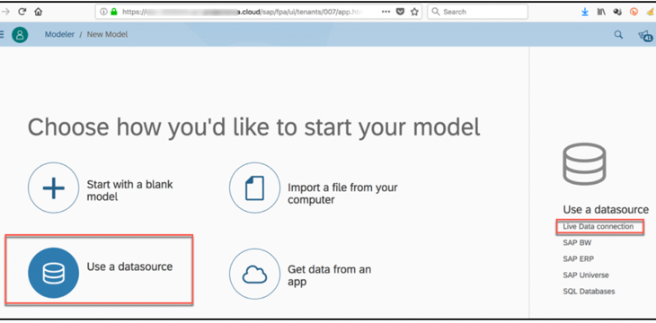

Consume CDS in Analytic Cloud
With Live Data
Connection

Slide 10

Exercise
Consume CDS in Analytics Cloud Code

Slide 11
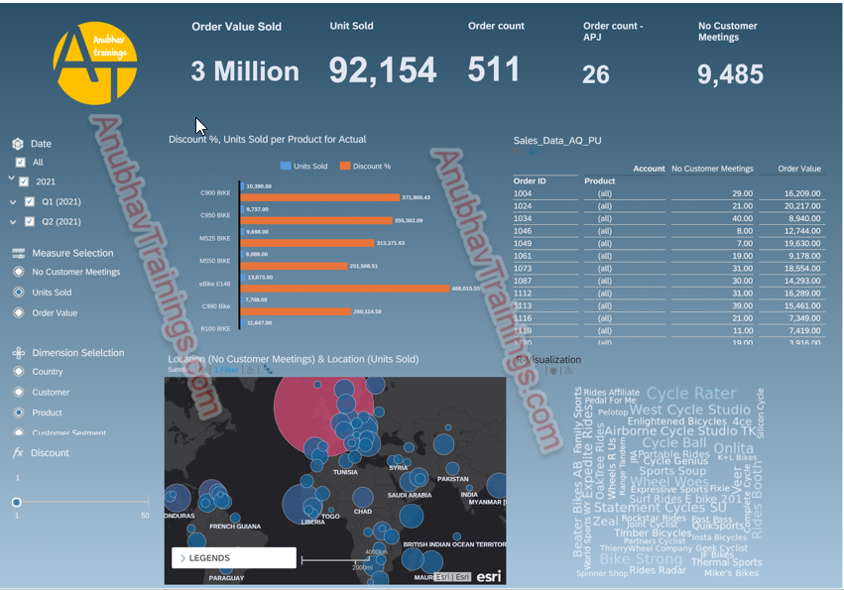
SAC Dashboard on top of CDS

Slide 12

End of Day 17
Trainer: Anubhav Oberoy

Slide 13

Trainer: Anubhav Oberoy

Slide 14
THANK YOU
If you cannot do
great things, do small things in a great way.
Anubhav Oberoy
https://www.anubhavtrainings.com

Slide 15


We’re committed to empower you to be
Most Desirable Resource
through powerful training solutions.
We build the workforce of the future.
250+
Corporate Clients
30,000+
Learners Trained
25000+
Learners Placed
FREE WEBINARS
Sign up for free webinars with industry experts every fortnight!
Enroll Now!
Contact us today!
https://anubhavtrainings.com/

Slide 16




More from AnubhavTrainings.com

